Slide 1

Citibike Case Study.
Group 1
Art Danielle Balahadia
Jenkins Kiwanuka
Sharath Kalappa
Jai
Anirudh

Slide 2

Agenda!
Citibike
Descriptive Analysis
Predictive Analysis
Prescriptive Analysis

Slide 3

Citibike
1

Slide 4
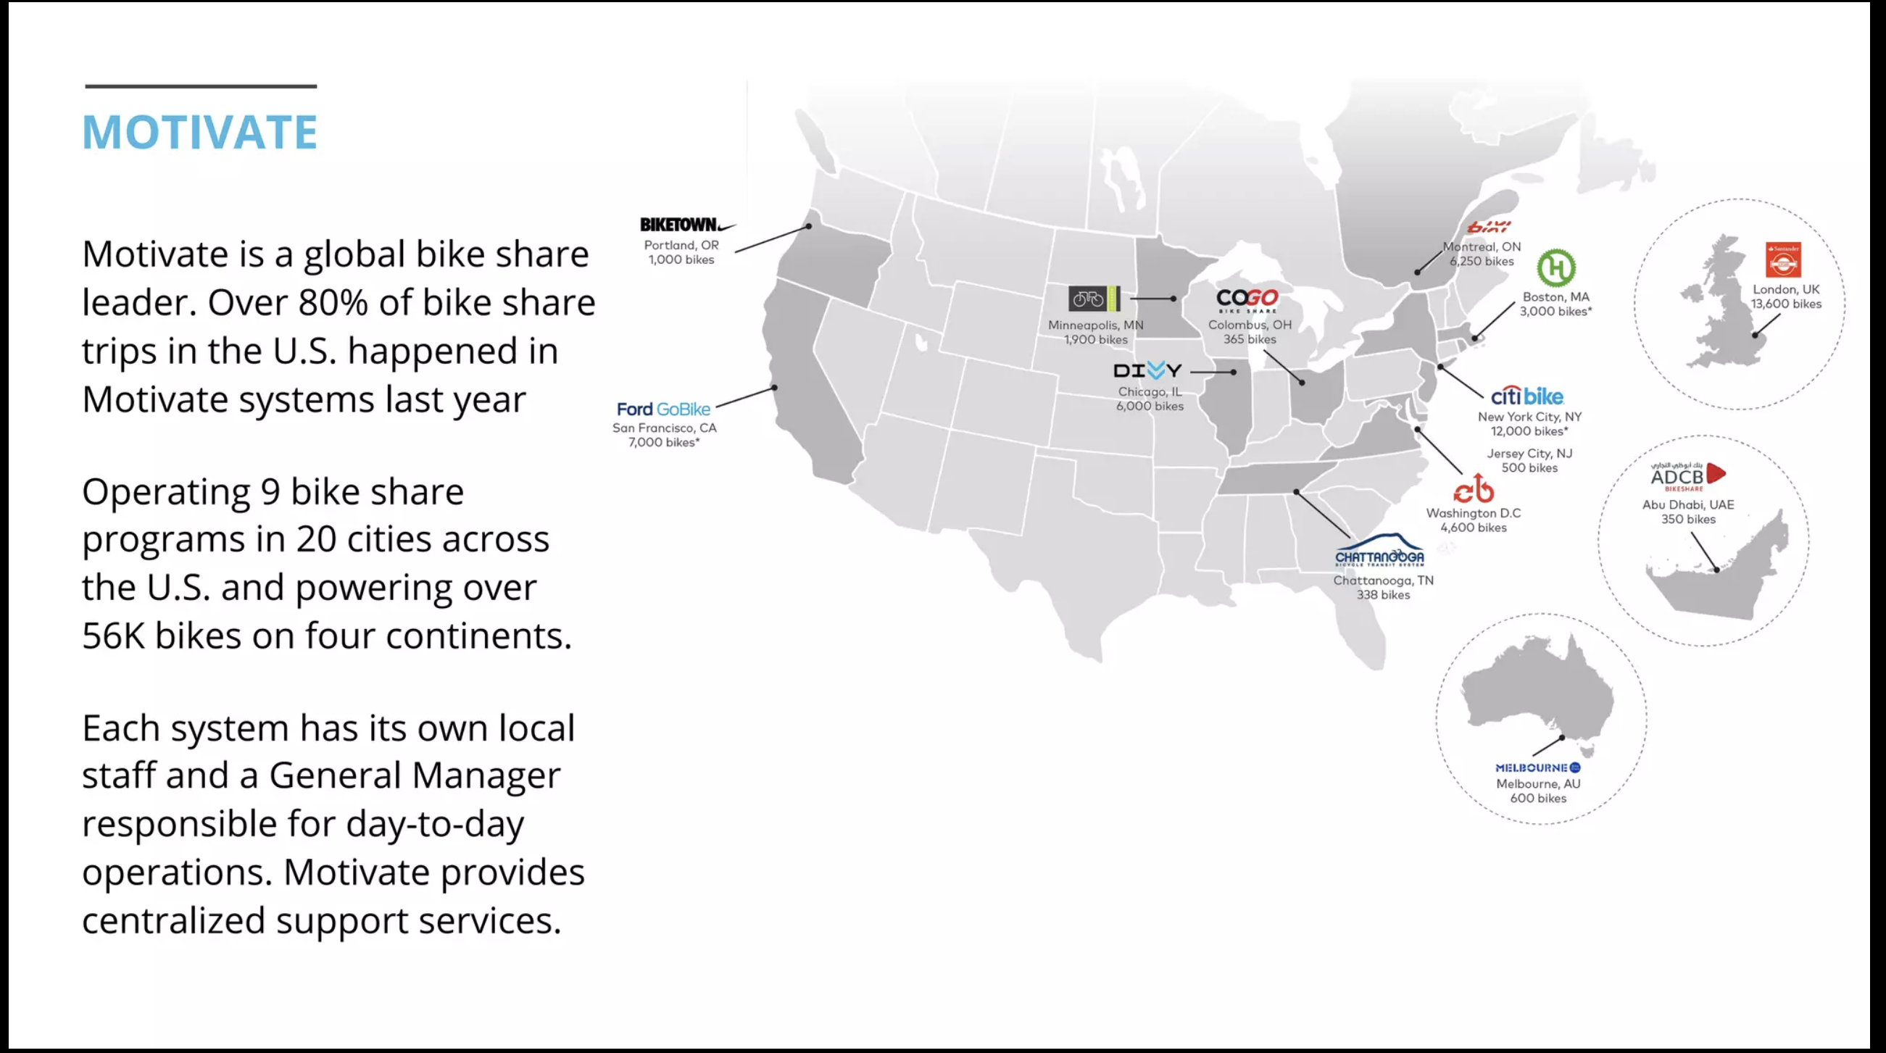

Slide 5
Did you know? Citibike Fun Facts
Citbike is the largest bike-sharing system in the country.
Ever since their launch in 2013, Citibike has grown to now 24,000 bikes and 47,000 docks across New York City
The company is projecting to increase to 40,000 bikes and 75,000 docks by 2024.
Citibike is available in New York (operated by Lyft) and in Miami (operated by DECOBIKE LLC)
Pricing
Annual Membership - $15 a month
Single Ride - $3.99 per trip
Day Pass - $15 per day
Source:
https://www.nytimes.com/2021/12/02/nyregion/citi-bike-parking-docking-station.html
https://citibikenyc.com/pricing

Slide 6
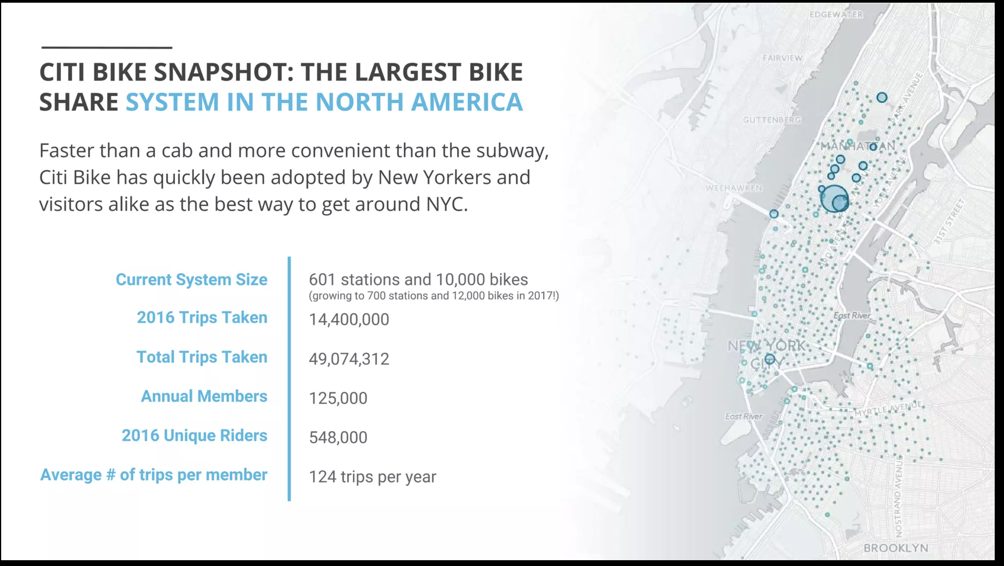

Slide 7
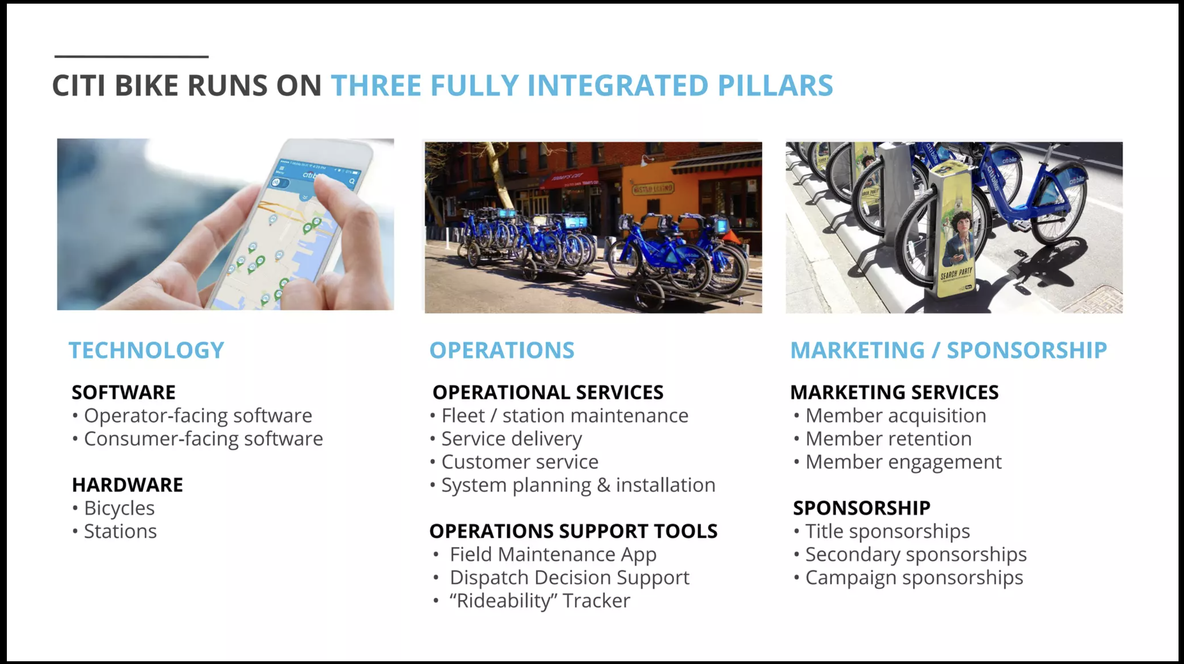

Slide 8
Descriptive Analysis
2

Slide 9
Demand summary
Mean: 45.8
Median: 40
Min: 1
Max: 284
1st Quartile: 21
3rd Quartile: 61

Slide 10

Correlations with Demand
Startnovehicle
0.4
Endnovehicle
0.33
Startcapita
0.32
Endcapita
0.18
Temperature
0.027
Trip distance
0

Slide 11
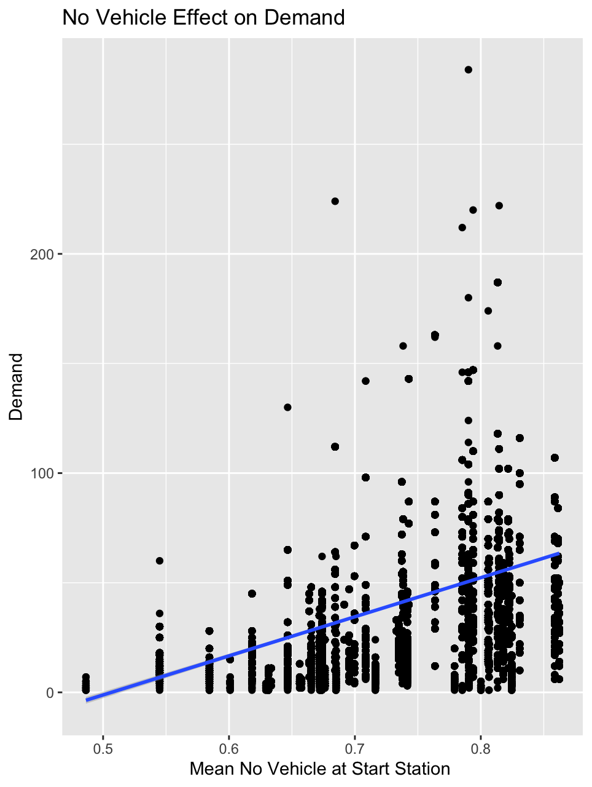
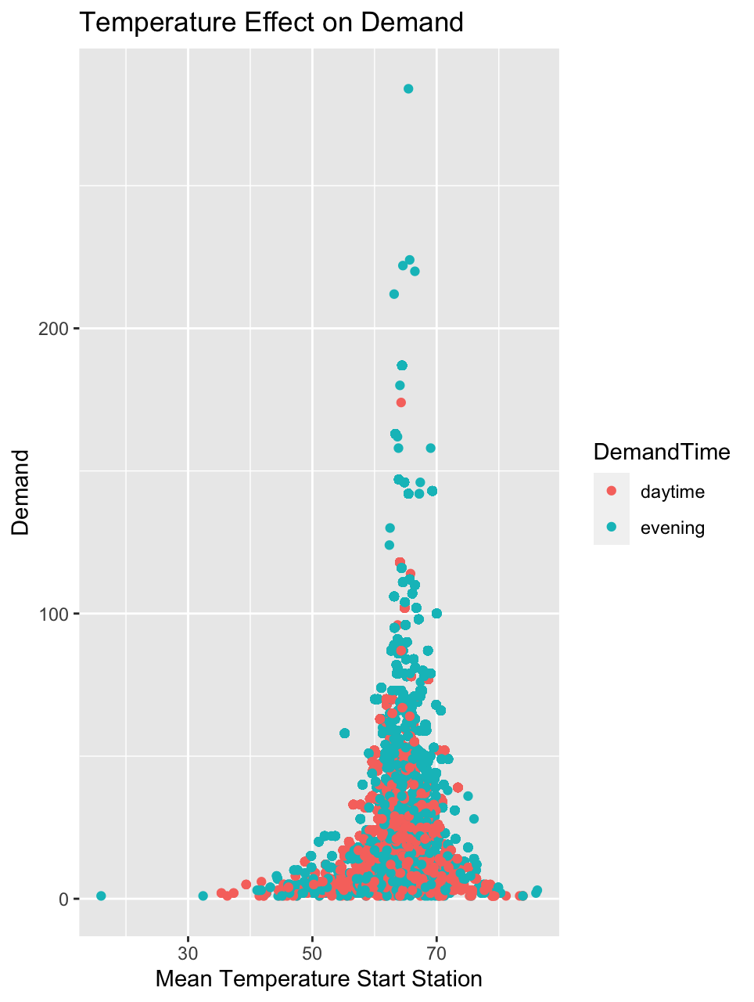
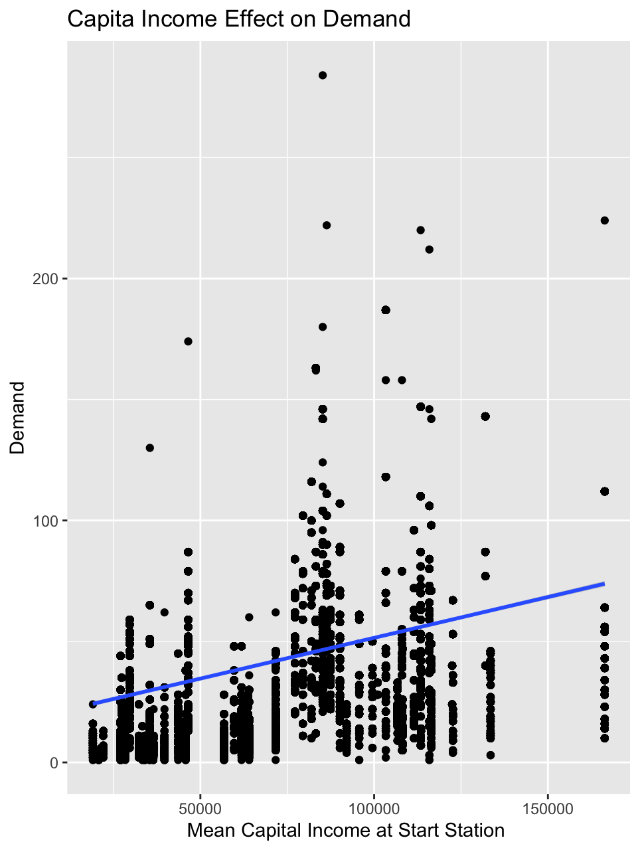
Effects on Demand

Slide 12
Predictive Analysis
3

Slide 13
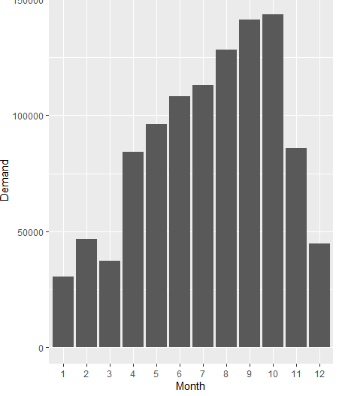
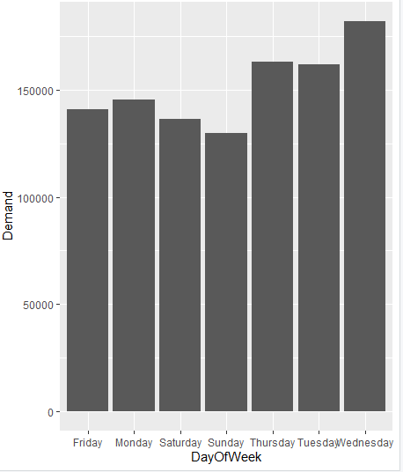
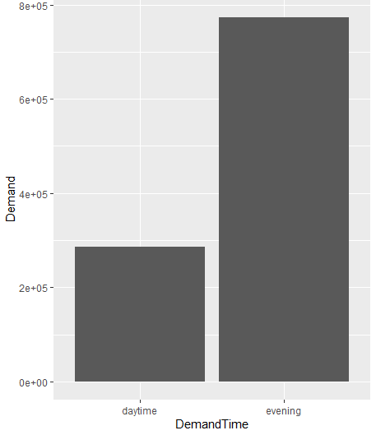
Demand and Predictor Relationship

Slide 14
Prescriptive Analysis
4

Slide 15

Station ID | Count of Start Station | Neighborhood
519 | 305 | Pershing Square North
426 | 220 | West St & Chambers St
435 | 217 | W 21 St & 6 Ave
497 | 208 | E 17 St & Broadway
402 | 202 | Broadway & E 22 St
Stations of Choice

Slide 16
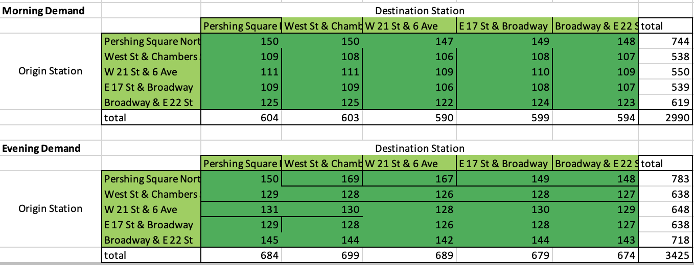
Citibike Optimization Model: Demand

Slide 17
Citibike Optimization Model: Allocation

Slide 18

Thanks!
Any Questions?

